Slide 1
PC Maintenance: Preparing for A+ Certification
Chapter 5: CPUs

Slide 2
Chapter 5 Objectives
Understand how a CPU holds and processes data
Identify ways by which a CPU is categorized and evaluated
Distinguish between PGA and SECC packaging
Understand how modern CPUs have evolved from earlier versions

Slide 3
Inside the CPU
Low-order bits: data that represents numbers to be calculated
High-order bits: data that represents instructions to the CPU

Slide 4
Inside the CPU
Instruction set: high-order bit codes that the CPU understands
Registers: holding areas for data inside the CPU

Slide 5
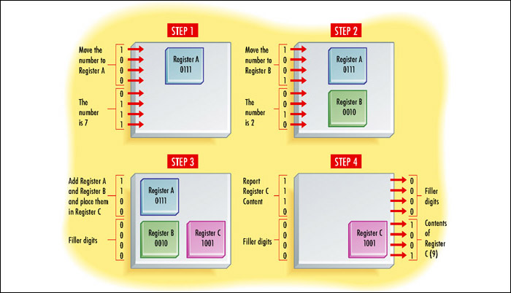
Example Process

Slide 6
Data Processing Speed
External speed
  Speed at which motherboard and CPU communicate
  Controlled by system crystal
Internal speed
  Speed at which CPU performs internal operations
  Usually a multiple of the external speed

Slide 7
Overclocking and Underclocking
Overclocking: operating a CPU at a higher internal speed than it is rated for
Underclocking: operating a CPU at a lower internal speed than it is rated for

Slide 8
Core Voltage
Voltage that the CPU requires to operate
Ranges from approximately +1.5v to +5v
Newer CPUs = lower voltages
Motherboard must provide correct voltage

Slide 9
CPU Cache Usage
L1 cache
  Front-side cache
  Holds data waiting to enter the CPU
  Built into the CPU on modern systems
L2 cache
  Back-side cache
  Holds data exiting the CPU
  Built into the CPU packaging, but on a separate chip

Slide 10
CPU Cooling
Fan
  Pulls heat away from CPU
Heat sink
  Spikes channel heat away from CPU

Slide 11
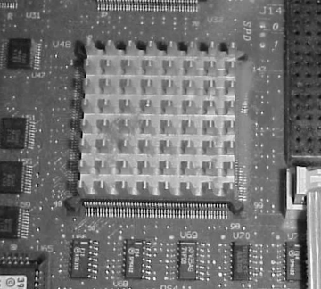
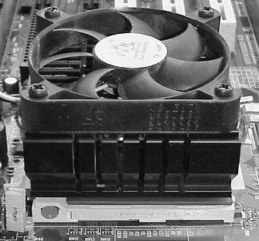
Passive/Active Heat Sink
  Passive: without fan
  Active: with fan

Slide 12
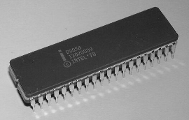
Pre-Pentium CPUs
8088
  16-bit internal registers
  20-bit address bus
  8-bit external data bus
  4.77MHz to 10MHz
  Optional 8087 math coprocessor

Slide 13
Pre-Pentium CPUs
80286
  Could run in Protected Mode
    More RAM could be addressed
    Multitasking
  Could run in Real Mode
    Backward compatible with applications for 8088
  Could use expanded memory on an ISA expansion board
  Up to 20MHz in speed

Slide 14
Pre-Pentium CPUs
80386 (i386)
  386 protected mode, 286 protected mode, and real mode
  Virtual memory
  Virtual 8086 mode
386DX versus 386SX
  32-bit versus 16-bit external data bus
  32-bit versus 24-bit address bus

Slide 15
Pre-Pentium CPUs
80486 (i486)
  Built-in coprocessor (on DX models)
  Clock multipliers
  Up to 120MHz (clock-tripled)
  First CPU to use ZIF packaging
486DX versus 486SX
  Disabled math coprocessor on 486SX

Slide 16
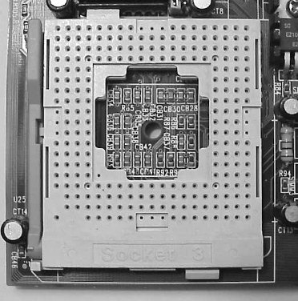
ZIF Packaging
Pin Grid Array (PGA)
Removable without force
Raise/lower lever

Slide 17
Pentium Packaging
Socket 4
  +5v socket
  Used for 1st Generation Pentium (60, 66MHz)
  273-pin
Socket 3
  Variable-voltage socket, +3.3v or +5v
  Introduced after Socket 4
  Works with either 486 or 1st Generation Pentium

Slide 18
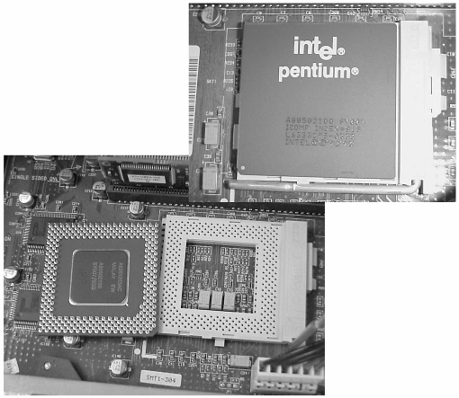
Pentium Packaging
Socket 5
  +3.3v socket
  2nd Generation Pentiums (77 to 100MHz)
  First to use staggered PGA (SPGA)
  320-pin

Slide 19
Pentium Packaging
Socket 6
  +3.3v socket
  Used for Pentium OverDrive and 486DX4
Socket 7
  Variable voltage socket, +3.3v or +5v
  321 pins (rather than 320 on Socket 5)
  Otherwise the same as Socket 5

Slide 20
Pentium Packaging
Super Socket 7 (Super7)
  Enhanced Socket 7
  Used with 2nd Generation Pentium and non-Intel competitor chips
  Provides split voltage capability that allows higher external than internal voltage

Slide 21
Pentium CPUs
First-Generation
  60 or 66MHz
  Used Socket 3 or Socket 4
Second-Generation
  75 to 100MHz
  Used Socket 5 or Socket 7
Third-Generation
  166 to 233MHz
  Adds MMX capability

Slide 22
Pentium Pro
Improvement on Second-Generation Pentium
Introduced quad pipelining
Introduced on-chip L2 cache
Lacked MMX
Optimized for 32-bit operating systems
Socket 8: +3v rectangular socket, 387 pins

Slide 23
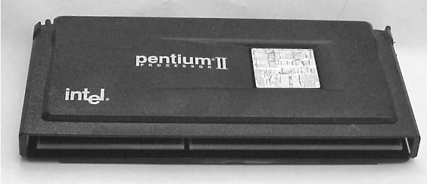
Pentium II
A fast Pentium Pro with MMX added
Internal speeds from 233 to 450MHz
External buses of 66 or 100MHz
Single Edge Contact Cartridge (SECC)

Slide 24
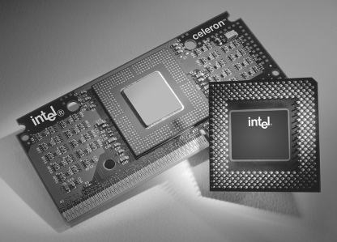
Celeron
Low-budget Pentium II (or Pentium III)
Packaging:
  Single Edge Processor (SEP)
  Socket 370

Slide 25
AMD K6
Competitor to Pentium II
Socket 7 PGA chip
Versions:
  K6: 166 to 300MHz
  K6-2: 266 to 475MHz, 3DNow! Technology
  K6-3: 400 to 450MHz, full-speed L2 cache

Slide 26
Pentium III
450MHz to 1GHz
Packaging:
  SECC2
  Socket 370
  Flip-Chip (FC) design

Slide 27
Pentium 4
1.3GHz to more than 2.8GHz
Socket 423 or Socket 478
NetBurst architecture
64-bit, 100MHz quad pipelining
20Kb L1 cache, 256KB full-speed L2 cache

